Slide 1

Software Developers Survey Analysis
Presented by: D Tadesse
BSc Mathematics & Statistics, https://github.com/datadesse
Last updated: 06 Aug 2023
London

Slide 2
TABLE OF CONTENTS
Executive Summary
Introduction
Methodology
Data Collection & Process
Results
Visualization – Charts & tables
Dashboard
Discussion
Findings & Implications
Conclusion
Appendix
Notes:
Outline will be an executive summary and then the table of contents
The table of contents will contain the sections and subsections of your report in order to give your audience an overview of the contents. This also enables readers to go directly to a specific section that may be more important to them.

Slide 3
EXECUTIVE SUMMARY
In this analysis I will provide evidences & suggestions to students where to work, which programing languages and database to study to remain competitive in the job market.
My research will answer the following questions:
Why TypeScript and Python are popular to study multiple languages & Python is best to study one language
Why Elasticsearch & Redis are popular databases and recommended to study
Why I suggest to work in some selected countries
Notes:
The first step in creating your report is properly creating an executive summary.
briefly explain the details of the project and
should be considered a stand-alone document.
This information is taken from the main points of your report and while it is acceptable to repeat information, no new information is presented

Slide 4
INTRODUCTION
Objective of this analysis is:
To identify programming languages and databases, job opportunities & make suggestions to students
Problems to:
Identify most popular programming languages, databases, average annual salary, countries where job opportunities available then present the result on dashboard
Suggest what to study to remain competitive in the job market and where to work
Notes:
The introduction explains the nature of the analysis, states the problem, and gives the questions that were to be answered by performing the analysis.

Slide 5
METHODOLOGY
Data source:
Demographic & technologies CSV files from the IBM website to answer problem 1
Actual data set was 90000 rows from Stack Over only 11552 rows of randomised data provided by IBM.
Extract names and average annual salary of programming languages from IBM website to answer problem 1 & 2
Extract programming languages job posting data from IBM website using Jobs API to answer problem 1 & 2
Kaggle.com was the original source of the data in CSV format but was converted into Json format by IBM
Notes:
Methodology explains the data sources that were used in the analysis and outlines the plan for the collected data. For example, was the cluster or regression method used to analyse the data?
introduce the research methods and data sources you used for the analysis. If you have collected new data, explain the data collection exercise in some detail. You will refer to the literature review to bolster your choice for variables, data, and methods and how they will help you answer your research questions

Slide 6
DATA COLLECTION & PROCESS
Demographic & Technologies csv files downloaded from IBM website then filtered out top 10 most popular Languages & Databases
Web scrapping: Python’s BeautifulSoup, Requests, Pandas & Json libraries used to scrape job data using Jobs API , names and average annual salary of programming language from IBM website, filtered out & converted the required data then created charts, tables and dashboards

Slide 7
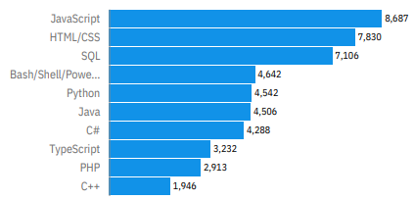
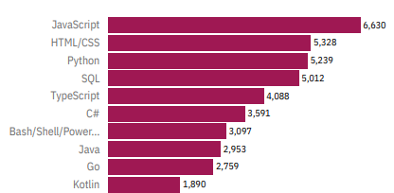
PROGRAMMING LANGUAGES TRENDS
Fig 1
Fig 1 indicates that the demand for Python & TypeScript increased suggesting that students would benefit if they study these languages
Top 10 Languages Current Year
Top 10 Languages Next Year

Slide 8
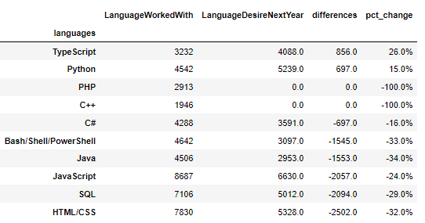
PROGRAMMING LANGUAGES COMPARISON
Fig 2
Fig 2 indicates that the demand for TypeScript and Python increased by 26% and 15% respectively suggesting that their popularity grew

Slide 9
PROGRAMMING LANGUAGE-FINDINGS & IMPLICATIONS
Findings
Despite TypeScript has low take up grew by 26%
Interest for Python increased by 15%
HTML/CSS & JavaScript have high take up but declined by -32% and -24% respectively
Implications
TypeScript and Python become very popular
HTML/CSS & JavaScript still dominate but their futurity is in question

Slide 10
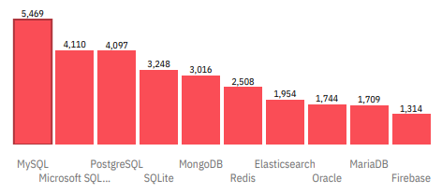
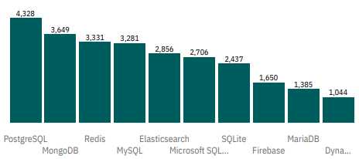
DATABASE TRENDS
Fig 3
Fig 3 shows that growing interest for Elasticsearch, Redis, Firebase, MongoDB, PostgreSQL increased suggesting that students would benefit if they study one or two of these databases
Top 10 Database Current Year
Top 10 Database Next Year

Slide 11
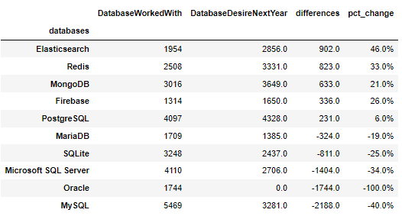
DATABASE COMPARISON
Fig 4
Fig 4 indicates that:
Interest for Elasticsearch, Redis, Firebase, MongoDB, PostgreSQL increased
Elasticsearch increased by a significant amount 46% suggesting that its popularity grew

Slide 12
DATABASE FINDINGS & IMPLICATIONS
Findings
The interest for Elasticsearch & Redis increased by a significant amount 46% & 33% respectively
Oracle and MySQL declined by huge amounts -100% and -40% respectively despite high take up
Implications
Elasticsearch & Redis are most popular databases
Oracle and MySQL dropping by a significant amount indication of their future uncertainty?

Slide 13
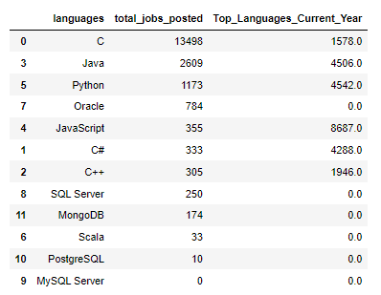
JOB ADVERT Vs LANGUAGES COMPARISON
Fig 5
Based on Fig 5 findings C, Java, Python & JavaScript have higher job vacancies and demand by employers

Slide 14
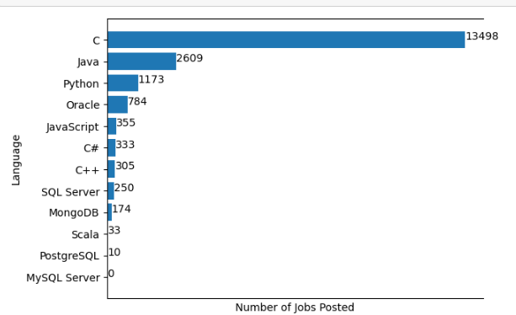
Job Postings by Number of Jobs
Fig 6
Fig 6 indicates that C, Java, Python & JavaScript programming languages have more job vacancies

Slide 15
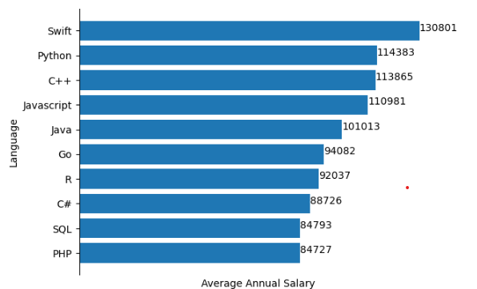
Languages by Descending Order of Salary
Fig 7
Fig 7 shows that Swift, Python,
C++, JavaScript and Java are well paid languages with salaries over 100K.

Slide 16
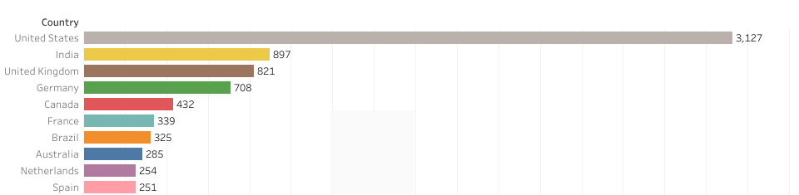
RESPONDENT COUNT BY COUNTRY
Fig 8
Fig 8 indicates that the US, India, UK & Germany have highest number participant indicating that students would have higher job opportunities if they worked in the these countries

Slide 17
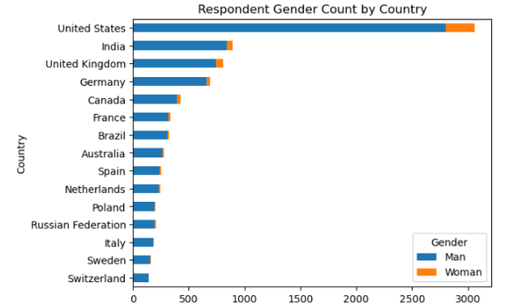
GENDER COUNT BY COUNTRY
Fig 9
Fig 9 shows that women have significantly lower participation in the survey than men.

Slide 18
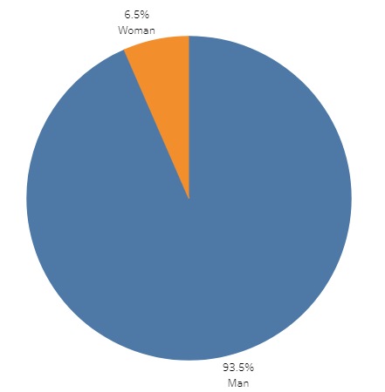
RESPONDENTS COUNT BY GENDER
Fig 10
Fig 10 shows that the number of women 731 (6.5%) who took part in the survey was significantly lower than men 10480 (93.5%). This result indicates that the field is dominated by men.

Slide 19
DASHBOARD
I was unable to generate Cognos dashboard link due to my IBM account issues. Alternatively I created similar charts using Python on Jupyter Notebook and Dashboards using Tableau Public.
My codes & dashboards for this analysis can be found on my GitHub page link below:
https://github.com/datadesse/IBM_Data_Analyst_Capstone_Project/tree/main

Slide 20
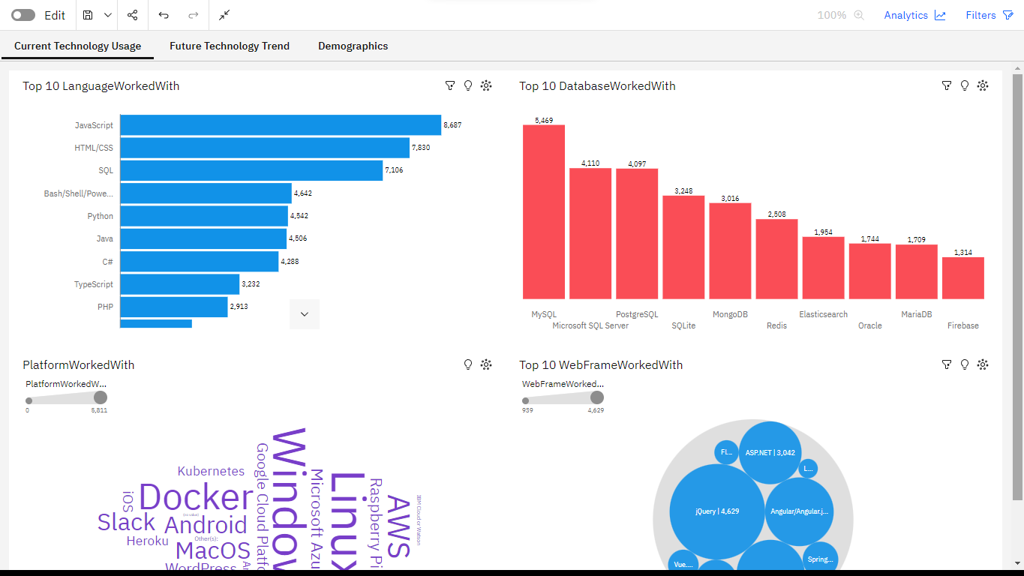
COGNOS DASHBOARD
Fig 11
Fig 11 shows Databases, Languages, Platform and Web Frame of the Next Year using Congos Dashboard

Slide 21
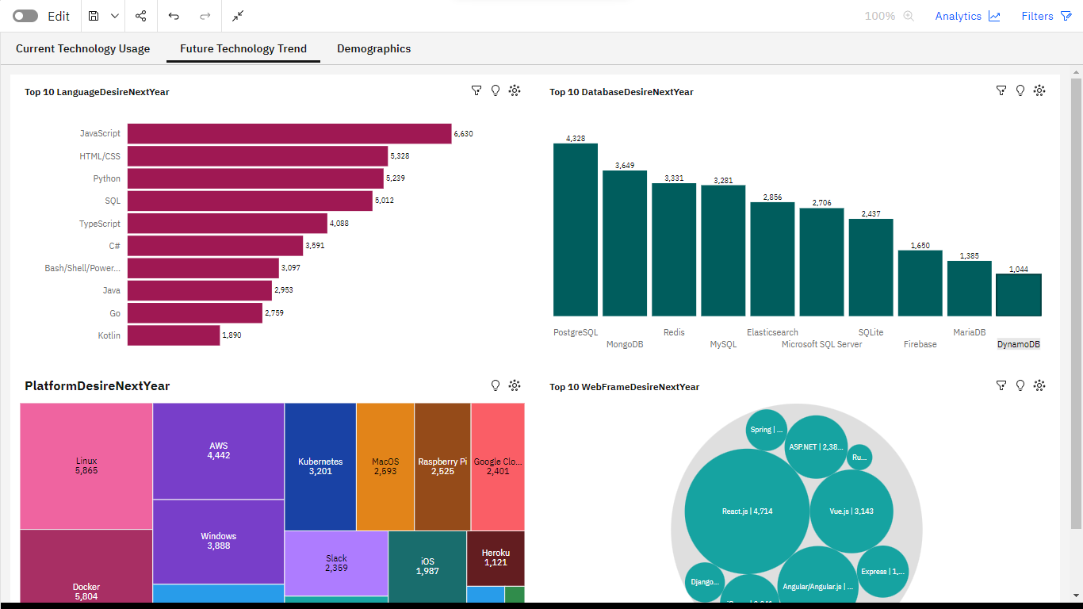
COGNOS DASHBOARD
Fig 12
Fig 12 shows Databases, Languages, Platform and Web Frame Current Year

Slide 22
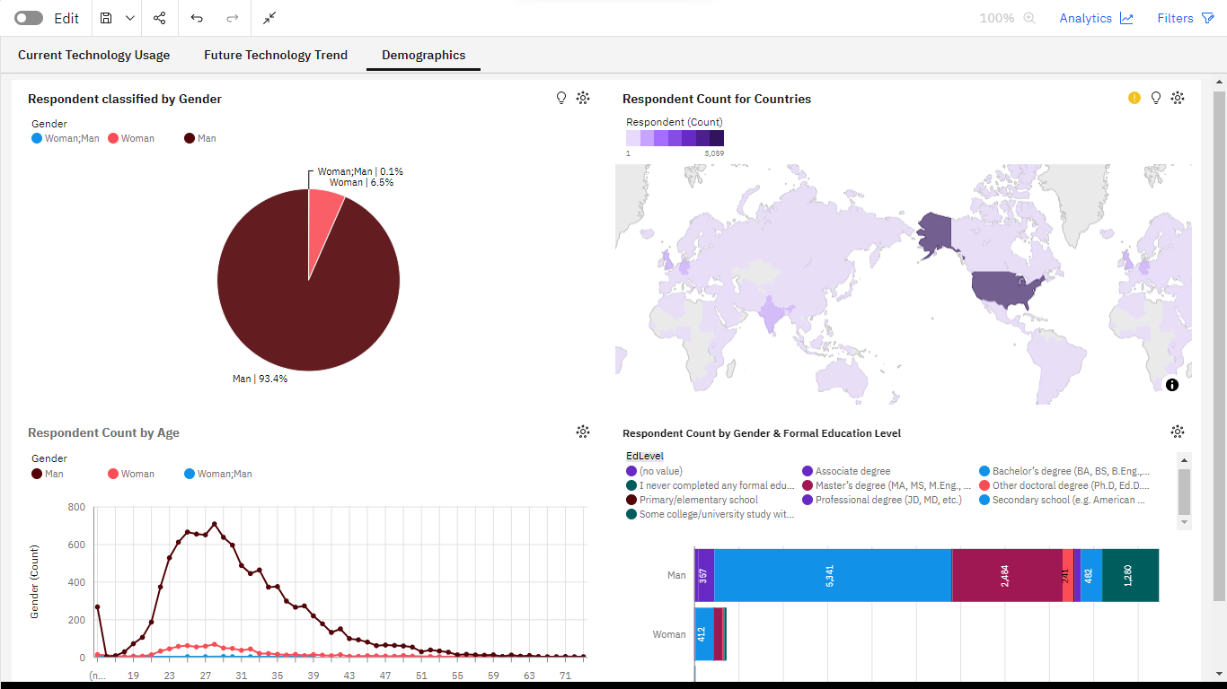
COGNOS DASHBOARD
Fig 13
Fig 13 shows demography of the respondents’- Gender, Age, Education Level and Country using Congos Dashboard

Slide 23
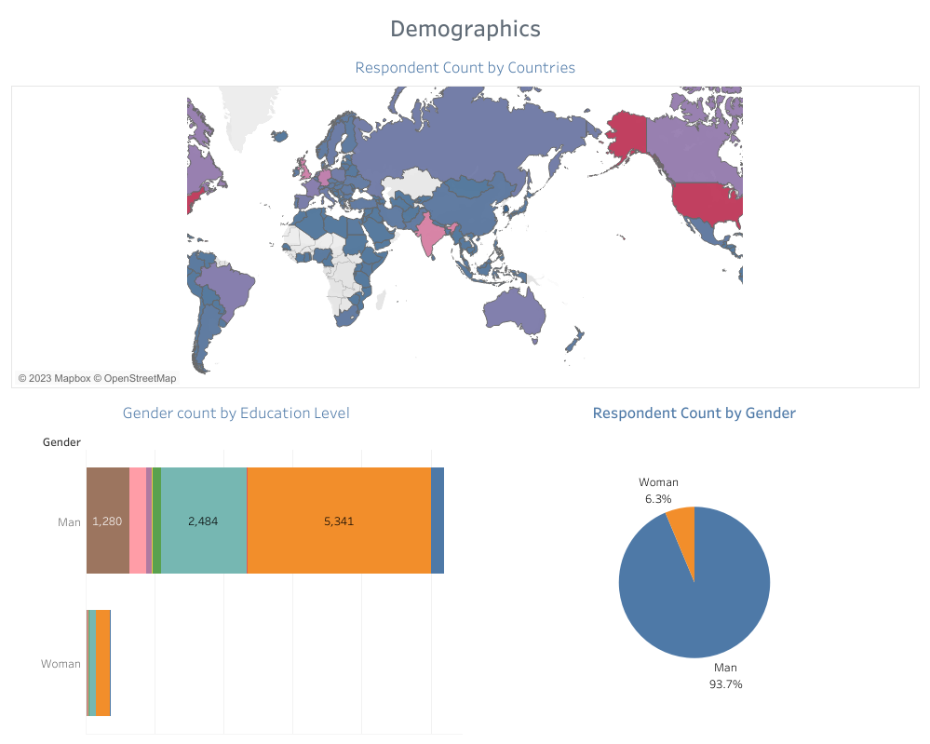
TABLEAU DASHBOARD
Fig 14
Fig 14 shows demography of the respondents’- Gender, Education Level and Country using Tableau Dashboard

Slide 24
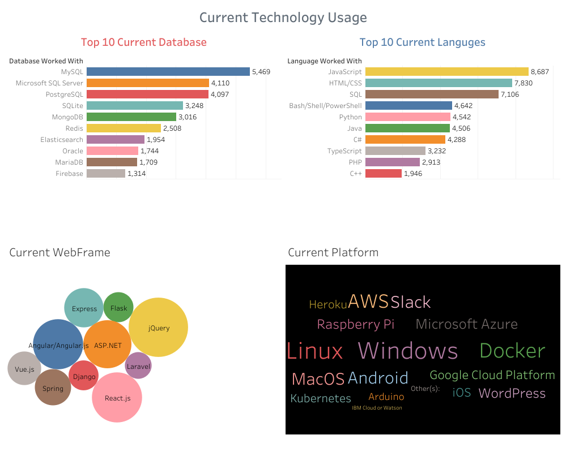
TABLEAU DASHBOARD
Fig 15
Fig 15 shows Current Technology Used of Databases, Languages, Platform and Web Frame using Tableau Dashboard

Slide 25
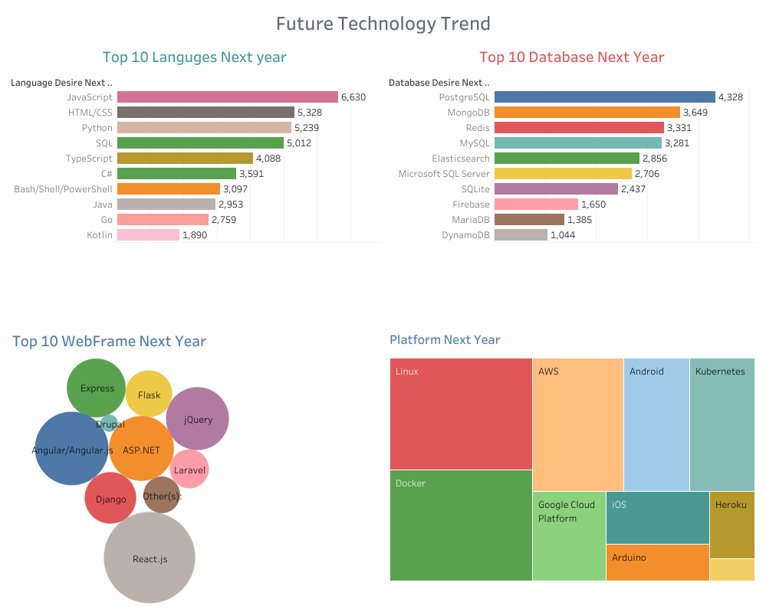
TABLEAU DASHBOARD
Fig 16
Fig 16 shows the Future Technology trend of Databases, Languages, Platform and Web Frame using Tableau Dashboard

Slide 26
OVERALL FINDINGS & IMPLICATIONS
Findings
Databases –Elasticsearch 46%, Redis 33%, Firebase 26%, MongoDB 21% increased by good amount showing growing interest for them
Languages- Despite TypeScript has low take up grew by 26%, Python increased by 15%,
US(3127), India(897), UK(821) & Germany(708) have highest number of participants.
Implications
Elasticsearch & Redis databases have higher demands than the rest
TypeScript and Python become most popular and leading programing languages
Students will have higher job opportunities if they worked in the US, India, UK & Germany.

Slide 27
RESULTS
According to my findings to remain competitive in the job market students would benefit if they study:
TypeScript and Python multiple languages or Python is best to study one Language
Elasticsearch & Redis multiple databases or Elasticsearch to study one Database
My investigation suggest that Students would be better off if they worked in the US, India, UK & Germany
Notes:
The results section.
This section goes into the detail of the data collection, how it was organized, and how it was analysed. This portion would also contain the charts and graphs that would substantiate the results and call attention to the more complex or crucial findings.
By providing this interpretation of data, you are able to give a detailed explanation to the audience and how it relates to the problem that was stated in the introduction.

Slide 28
DISCUSSION
One or multiple languages/databases to study?
For students who don’t have the time & resources I suggest that they study Python (one language) as its popularity is growing fast & becoming supreme.
Depending on the field students want to work Elasticsearch is best to study one database.
Overall if students study multiple languages (TypeScript and Python) and databases (Elasticsearch & Redis) will stand out and become competitive in the job market.
Notes:
For this section, you would begin to engage the audience with a discussion of your implications that were drawn from the research.
For example, let’s say you were conducting research for top programming languages for college graduates. Would you find they need to learn multiple languages to remain competitive in the job market, or would one language always reign supreme?

Slide 29
CONCLUSION
Python is top programming language with highest job vacancies, demand by employers as well as excellent salary over 100K.
TypeScript and Python popularity increased by a good amount so students would benefit if they study these languages
Elasticsearch & Redis databases popularity increased by a good amount indicating that growing interest suggesting that students would benefit if they study these databases.
US, India, UK, & Germany are countries with highest number of participant who took part in the survey suggesting that students have highest job opportunities if they worked in these countries.
Limitations
The actual Demographic & Technologies data set from Stack Over was 90000 rows but only 11552 rows of randomised data provided by IBM for this analysis purpose. Conclusions drawn here may not reflect the real world scenario therefore further analysis is required on larger data.
Suggestions:
Reach out more women during data collection to increase their number taking part in the survey
Encourage more women to take up programing languages & databases to grow their contribution in the field.
Notes:
This final section should reiterate the problem given in the introduction and gives an overall summary of the findings.
It would also state the outcome of the analysis and if any other steps would be taken in the future

Slide 30
Appendix
Data source
Demographic & technologies CSV files (90,000 rows) collected & produced by Stack Over from 2019 survey they conducted with professional software developers but from this only 11552 rows of randomised data (IBM)
Programming languages job posting data- Kaggle.com was the original source in CSV format but IBM converted it into Json format for this analysis purpose
Gender Gap
From 11,552 software developers who took part in the survey the number of women respondents were only 731 (6.5%) whereas men 10480 (93.5%).
Women's contribution was significantly lower than men. This result indicates that men dominated the software developers’ field and is crucial to closing the gender gap.
Acknowledgements and credits to:
Stack Overflow for conducting the survey, collecting, producing and making the the dataset available open source.
IBM & Coursera for providing IBM Data Analyst Professional Certificate course & facilitating resources for my analysis.
Notes:
Appendix is where you can have additional information on data, data visuals, as well as overall context for
the presentation that may not work within the overall flow itself.
This section would contain information that: really didn’t fit in the main body of the report, but you deemed it was still important enough to include.
This type of information could include locations where the raw data was collected or
The demographic csv file contains the survey participants’ country, education level, gender and age
The technologies CSV file contains programming languages, databases, platforms and web frames
other details such as resources,
acknowledgements
references

Slide 31
Thank You

